Slide 1
ANALYSIS OF WOMEN SAFETY IN INDIAN CITIES USING MACHINE LEARNING ON TWEETS
Under the esteemed guidance of: Presented by:
Mrs. CH. SWARNALATHA. P. Shivani (4511-19-733-022)
Assistant Professor(c) S. Srivani (4511-19-733-026)
Dept. of CSE,UCET, MGU. Y. Swapna (4511-19-733-655)

Slide 2
CONTENTS
Objective
Literature Survey
Problems identified
Solution proposed
Proposed architecture
Modules
Result Analysis
UML diagrams
Requirements
Conclusion
References

Slide 3
OBJECTIVE
The role of social media in promoting the safety of women in Indian cities.
To develop a sense of responsibility in common Indian people towards the safety of women surrounding them.
To bring awareness among Indian youth culture.

Slide 4
LITERATURE SURVEY
1. Design of women safety device: In this system the author used MOSFET, flyback transformer which harms the person who tries to abuse women.
Advantage is that it presents the technology used for women safety empowering women against crime.
Disadvantage is it fails when it comes to the social media platforms as it is completely online.

Slide 5
2. Analysis of tweets concerning women’s safety from a sentimental perspective: In this system author has used only TWEEPY package.
So the advantage is they have used python package which is efficient approach.
Disadvantage is to download tweets from twitter from the internet but every time internet is not available.

Slide 6
3. Sentiment analysis of top colleges in India using twitter data: In this system the author has done a comparatives analysis on SVM and naive bayes.
Advantage is duplicate tweets and spelling corrections can be removed using probabilistic models based on bayes theorem.
Disadvantage is it can be further processed in other technologies such as image processing also.

Slide 7
4. Determining the sentiment of opinions: In this system the author has done with sentiment recognition majorly on words.
Advantage is the author has given sentiment analysis on the opinion on the given topic.
Disadvantage is it can be done on sentences with weak opinion bearing words.

Slide 8
PROBLEMS IDENTIFIED
User emotion analysis can be done.
It can be done on image data also.
The advertisements in televisions, radio about women harassment is not so effective neither to stop such activities nor to analyse the safety of women.

Slide 9
SOLUTION PROPOSED
In our proposed solution we have used Machine learning algorithms that can help us to organize and analyse the huge amount of data.
Algorithms used are SVM, Decision tree, Random forest and approaches are very effective and useful.
A flask API is used to find out the message is negative or positive.

Slide 10
PROPOSED ARCHITECTURE
Data collection
Data pre-processing
Modelling
Evaluation

Slide 11
MODULES
Data Collection
Data Cleaning
Modelling
User login/signup
Evaluation

Slide 12
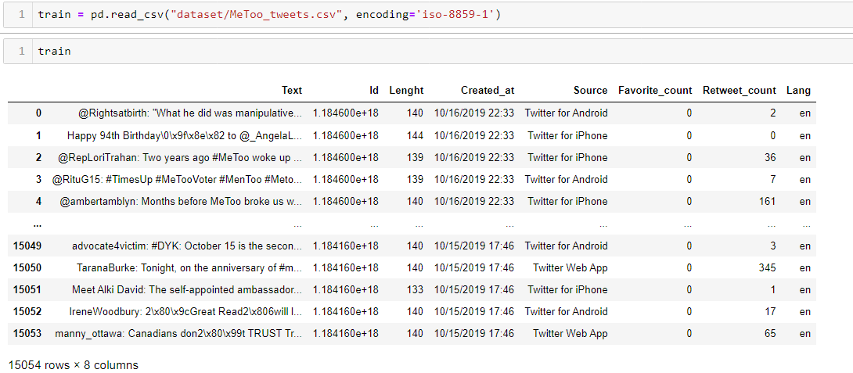
DATA COLLECTION
This is the data set we have collected it from Kaggle[1]

Slide 13
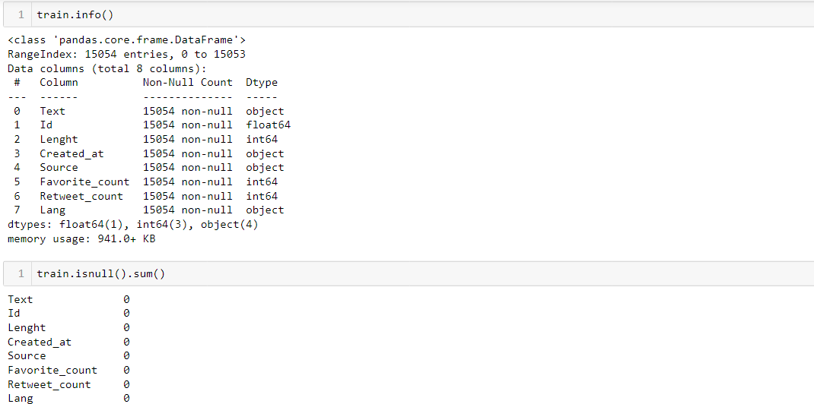
DATA CLEANING
This is Data cleaning, using .isnull.sum() we can find missing values in the data set.

Slide 14
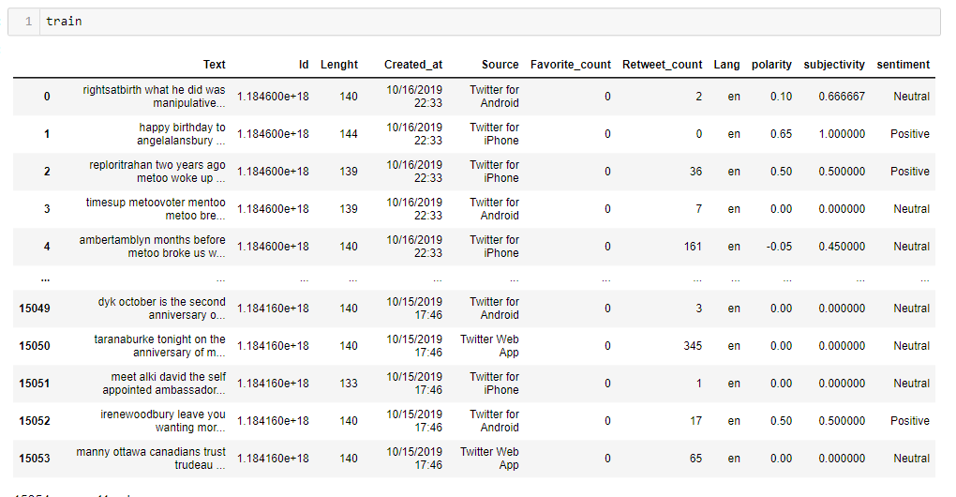
Dataset obtained after applying polarity, subjectivity and sentiment

Slide 15

Modelling
Decision Tree:
Decision Tree is a Supervised learning technique that can be used for both classification and Regression problems. It is called a decision tree because, similar to a tree, it starts with the root node, which expands on further branches and constructs a tree-like structure.
The decisions or the test are performed on the basis of features of the given dataset.
It is a graphical representation for getting all the possible solutions to a problem/decision based on given conditions.

Slide 16

Support Vector Machine
Support Vector Machine or SVM is one of the most popular Supervised Learning algorithms, which is used for Classification as well as Regression problems.
However, primarily, it is used for Classification problems in Machine Learning.
The goal of the SVM algorithm is to create the best line or decision boundary that can segregate n-dimensional space into classes so that we can easily put the new data point in the correct category in the future. This best decision boundary is called a hyperplane.

Slide 17
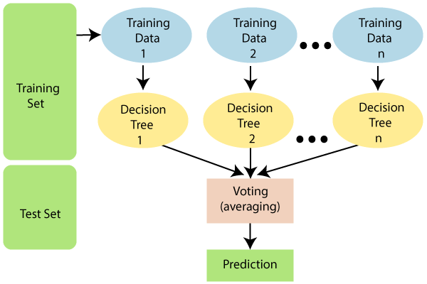
Random forest:
Random Forest is a popular machine learning algorithm that belongs to the supervised learning technique. It can be used for both Classification and Regression problems in ML. It is based on the concept of ensemble learning, which is a process of combining multiple classifiers to solve a complex problem and to improve the performance of the model.
As the name suggests, "Random Forest is a classifier that contains a number of decision trees on various subsets of the given dataset and takes the average to improve the predictive accuracy of that dataset." Instead of relying on one decision tree, the random forest takes the prediction from each tree and based on the majority votes of predictions, and it predicts the final output.
The greater number of trees in the forest leads to higher accuracy and prevents the problem of overfitting.

Slide 18
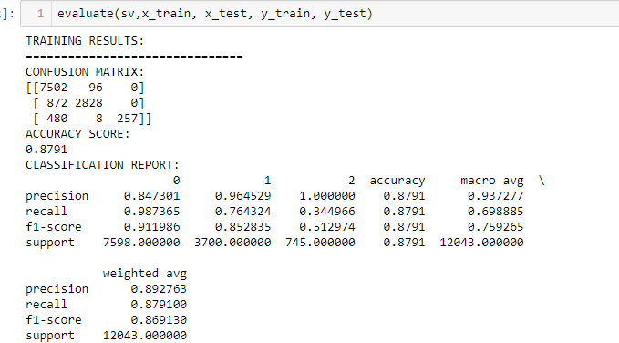
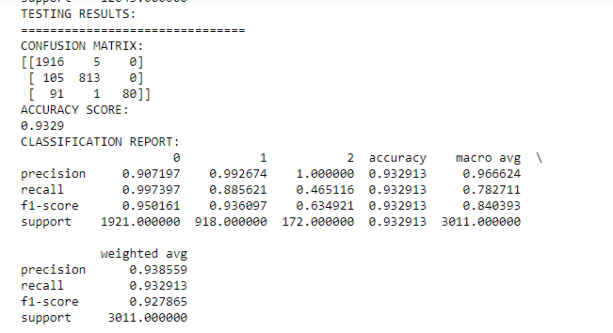
Model building using Support Vector Machine(SVM)

Slide 19
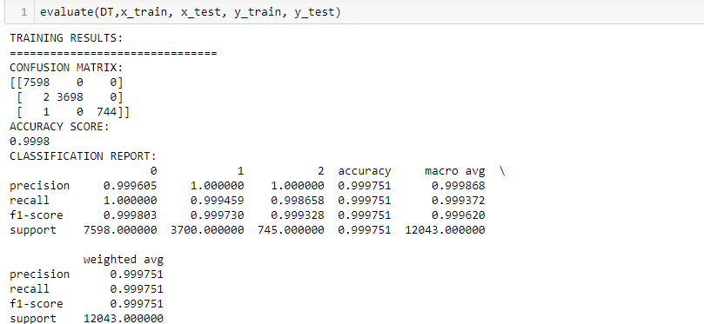
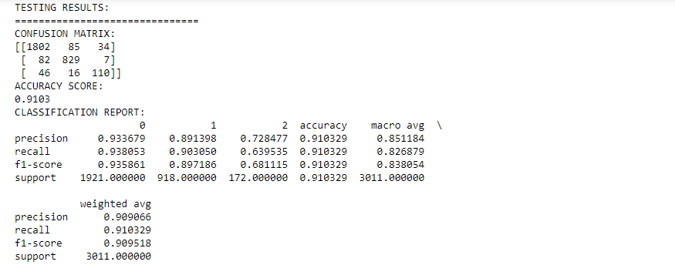
Model building using Decision Tree(DT)

Slide 20
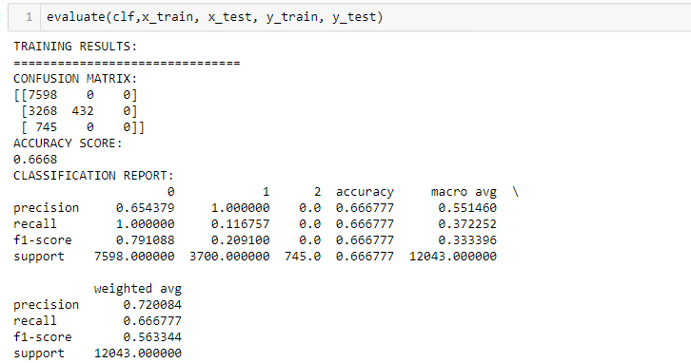
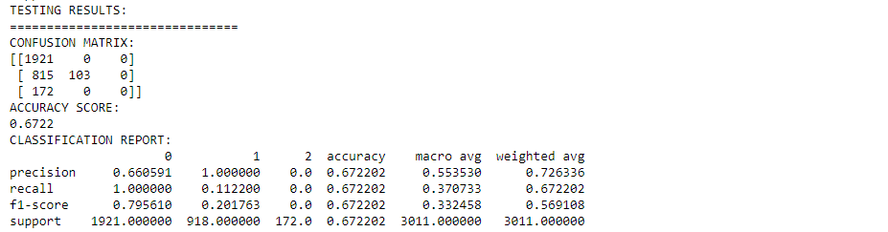
Model building using Random Forest(RF)

Slide 21
Result analysis
Algorithm | Support Vector Machine | Random Forest | Decision Tree
Accuracy | 0.87 | 0.66 | 0.99
Precision 0 1 2 | 0.84 0.96 1.00 | 0.65 1.00 0.00 | 0.99 1.00 1.00
Recall 0 1 2 | 0.98 0.76 0.34 | 1.00 0.11 0.00 | 1.00 0.99 0.99
F1 Score 0 1 2 | 0.91 0.85 0.51 | 0.79 0.20 0.00 | 0.99 0.99 0.99
Support 0 1 2 | 7598 3700 754 | 7598 3700 754 | 7598 3700 754

Slide 22

Home page

Slide 23
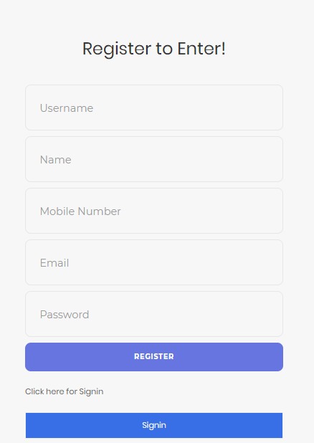
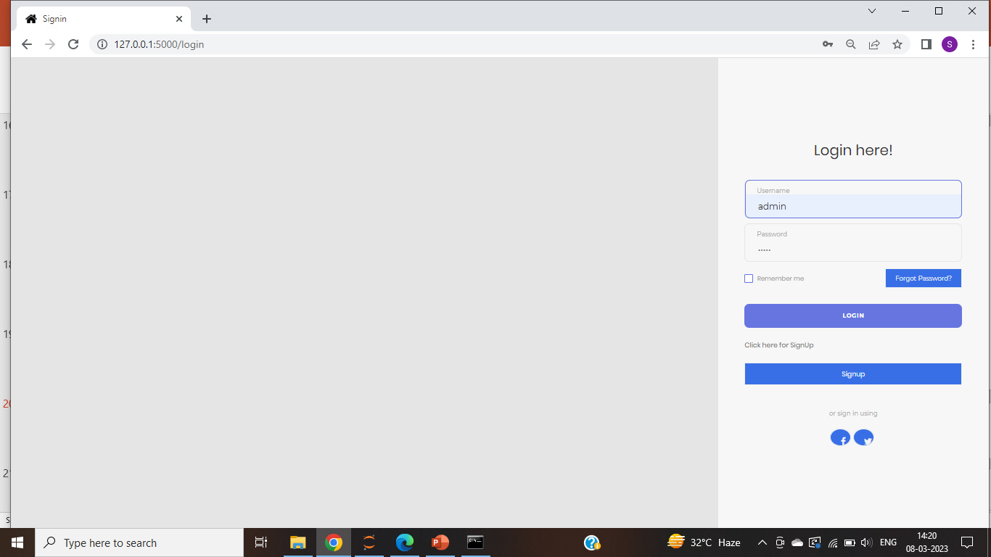
User login/signup

Slide 24
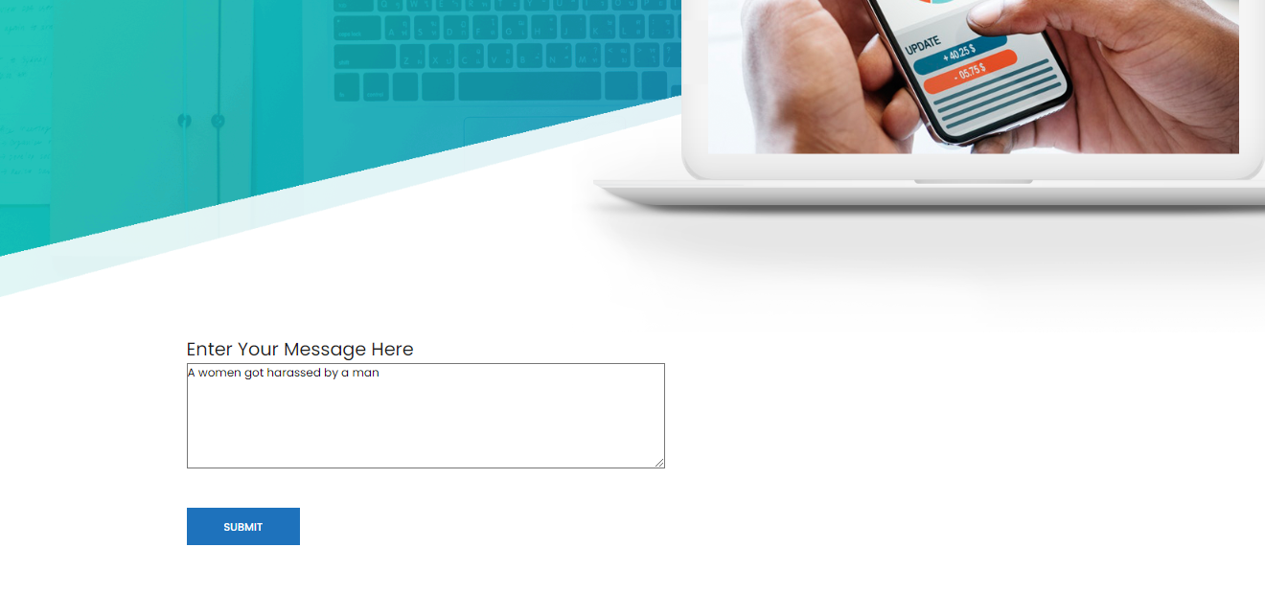
User Input

Slide 25
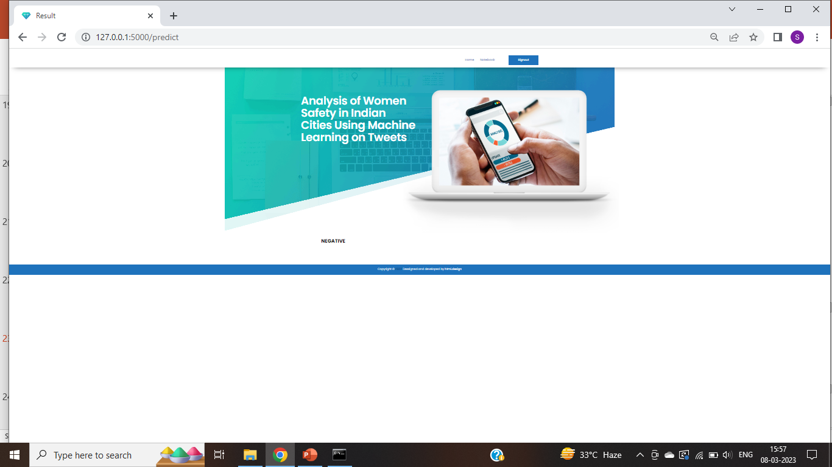
Results

Slide 26
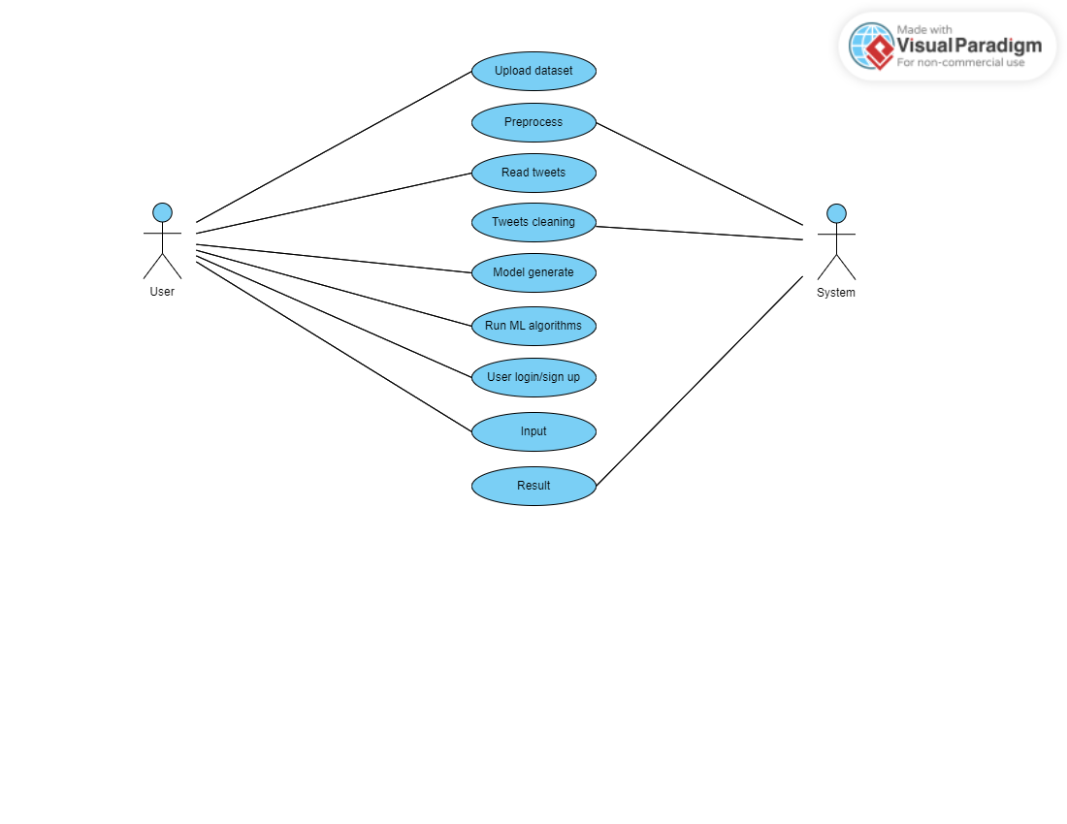
Uml diagrams
Use case diagram

Slide 27
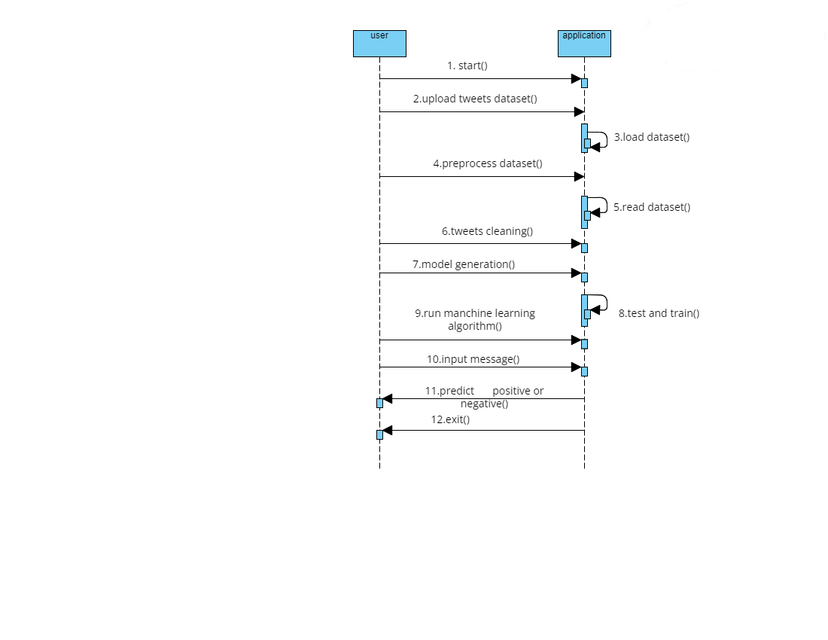
Sequence Diagram

Slide 28
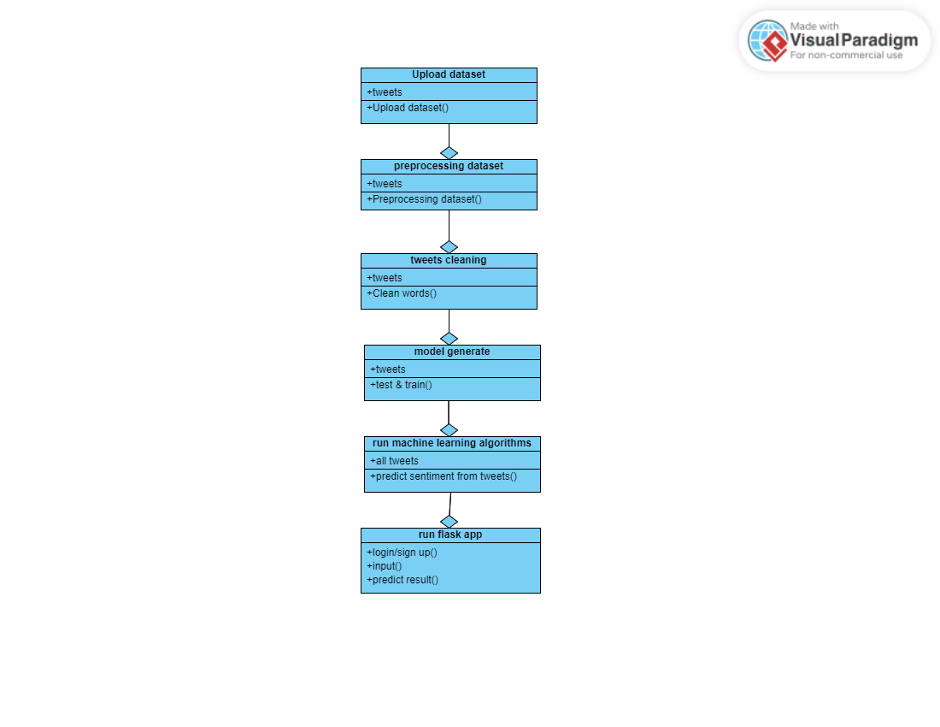
Class Diagram

Slide 29
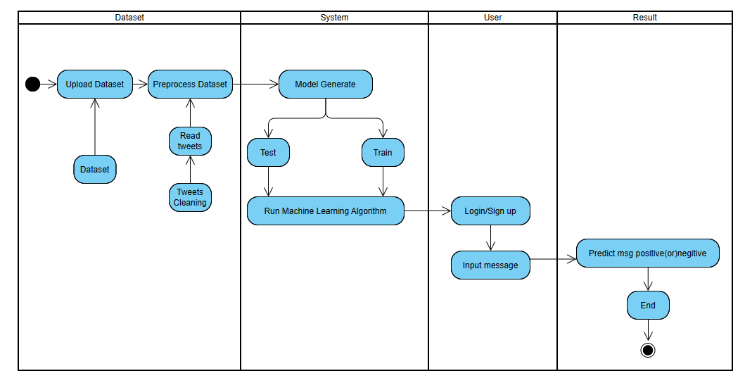
Activity Diagram

Slide 30
SYSTEM REQUIREMENTS
Hardware requirements
Processor:i3 or above
RAM: Min 4GB
Software requirements
Operating System : Windows 7 or above
Programming language : Python 3
IDE : Jupyter Notebook

Slide 31
CONCLUSION
Here by, we conclude that our project entitled Analysis of women safety in Indian cities using machine learning on tweets predicts the given message is positive or negative and we also a did comparatives analysis of machine learning algorithms such as Decision Tree, Support Vector Machine, Random Forest and decision tree gives the best accuracy of 99%.Further it can be extended to other social media platforms such as Facebook and Instagram and can be extended using deep learning techniques.

Slide 32
REFERENCES
www.Kaggle.com
Sahayak, V., Shete, V., & Pathan, A. (2015). Sentiment analysis on twitter data. International Journal of Innovative Research in Advanced Engineering (IJIRAE), 2(1), 178-183.
Mamgain, N., Mehta, E., Mittal, A., & Bhatt, G. (2016, March). Sentiment analysis of top colleges in India using Twitter data. In Computational Techniques in Information and Communication Technologies (ICCTICT), 2016 International Conference on (pp. 525-530). IEEE.

Slide 33
THANK YOU

